Slide 1

Notes:
---Lizzie---
Introduction

Slide 2
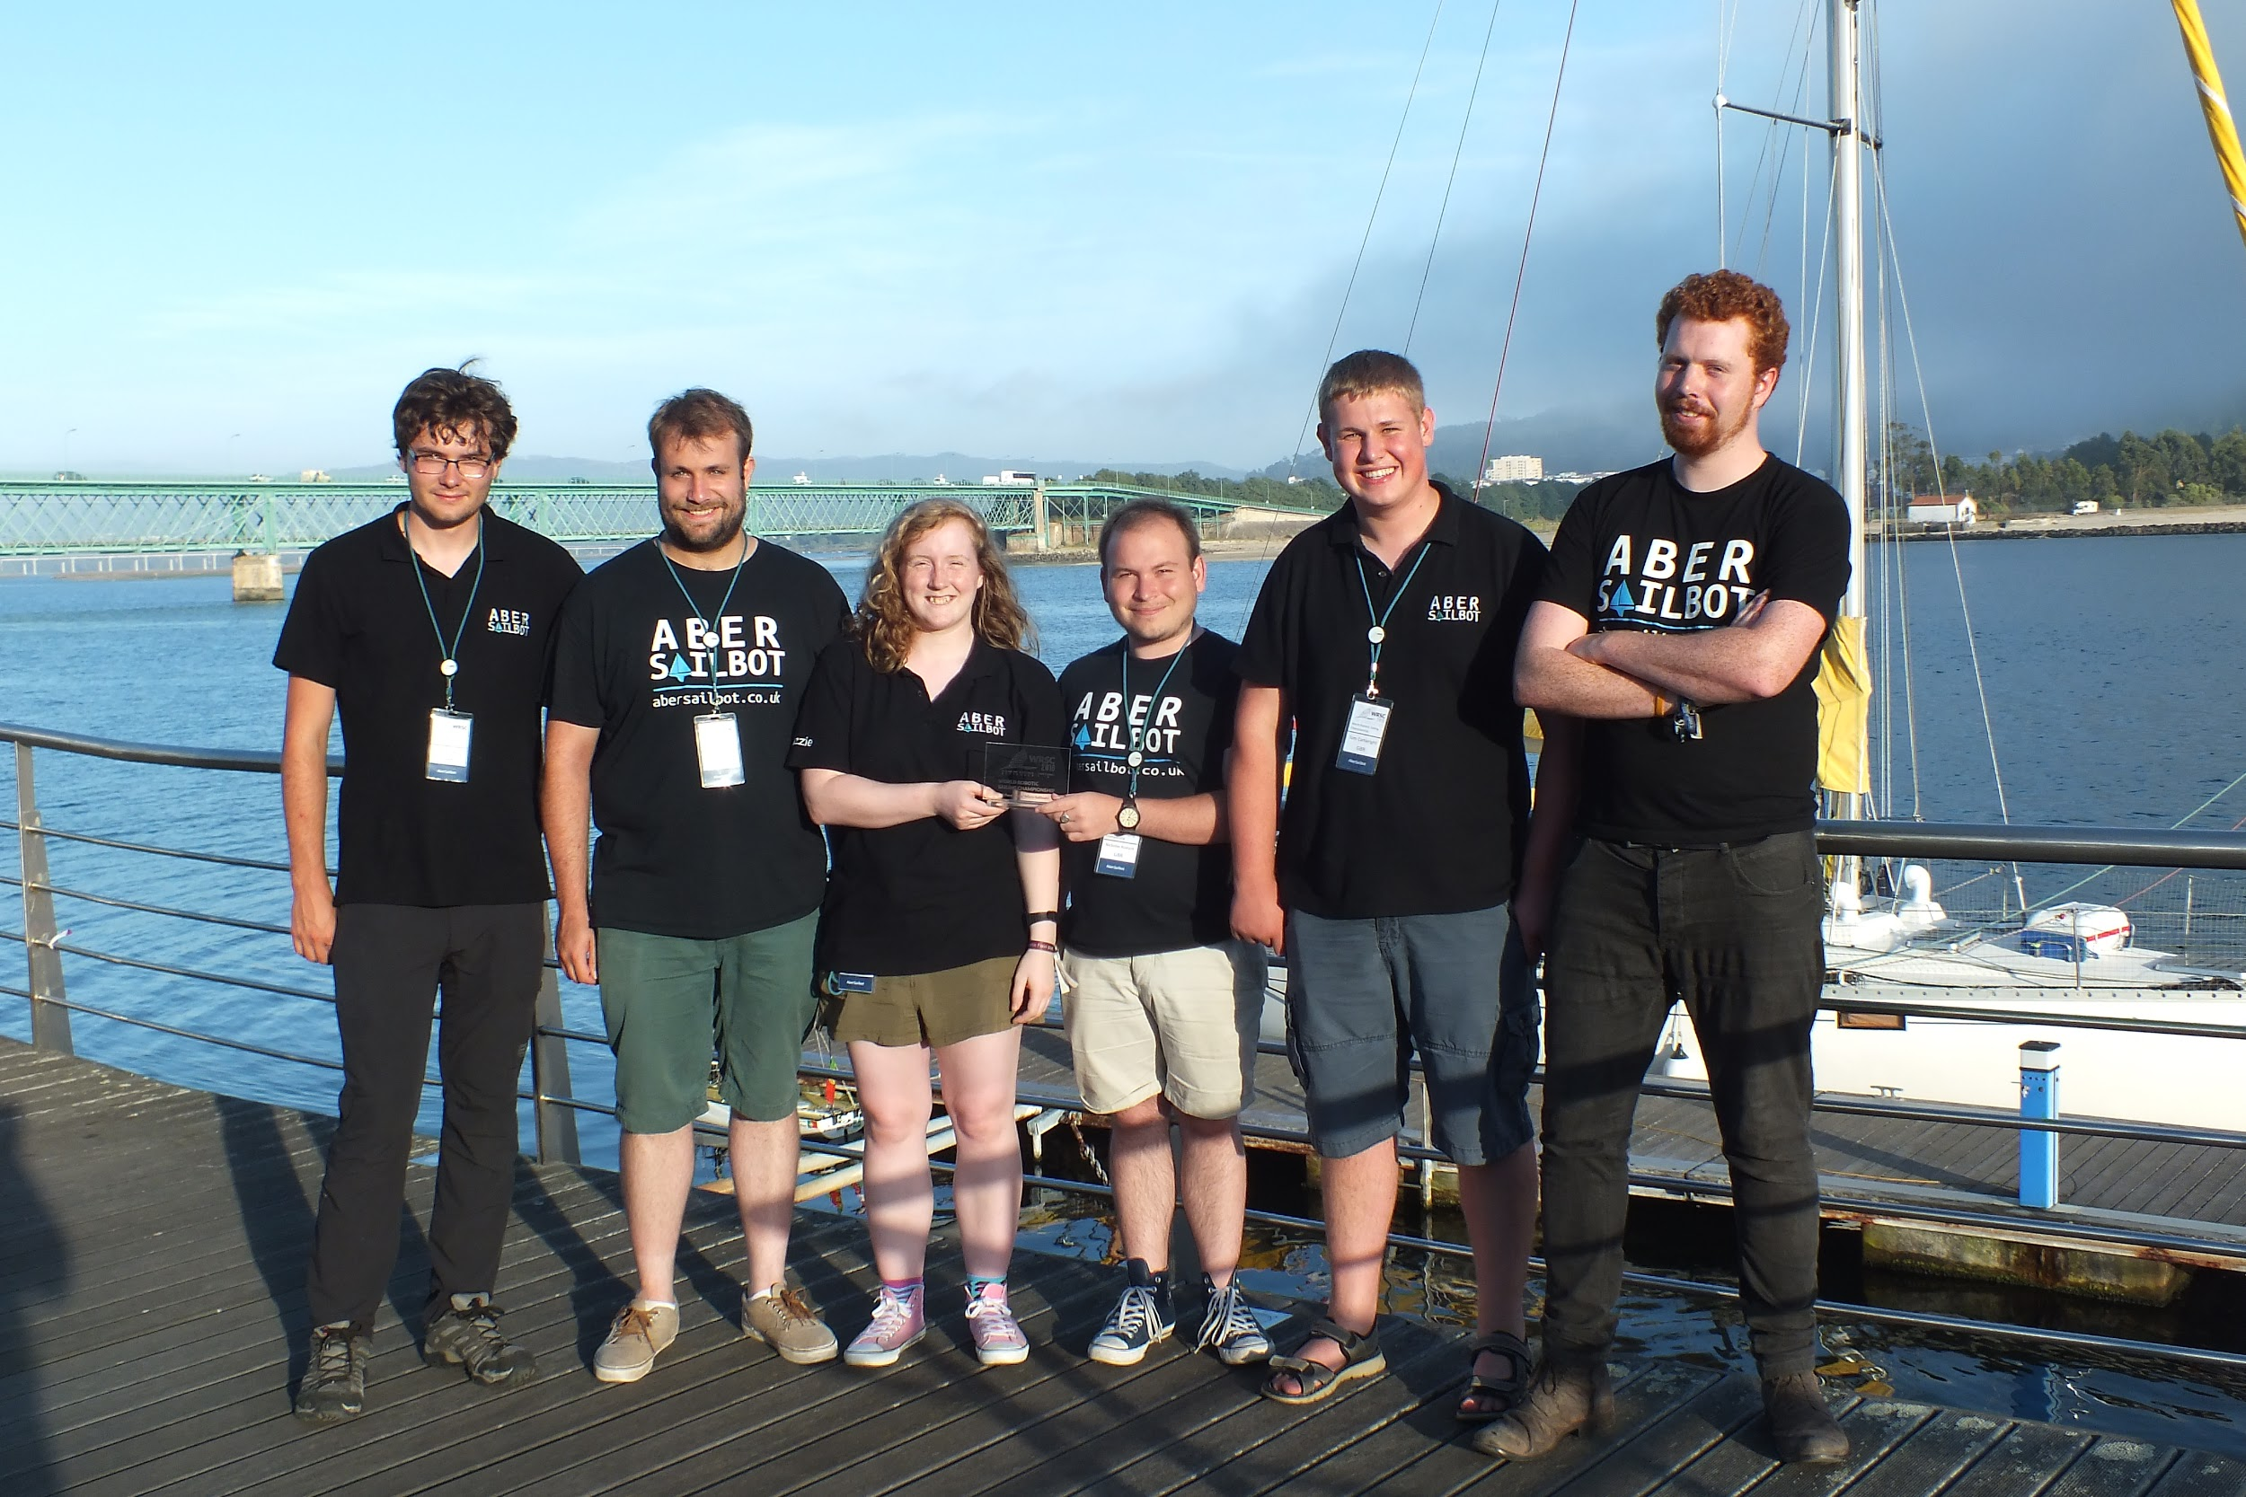



The Team
fb.com/abersailbot @abersailbot sailbot@aber.ac.uk
Notes:
We are AberSailbot!
Student led
Few members
Want more to join

Slide 3
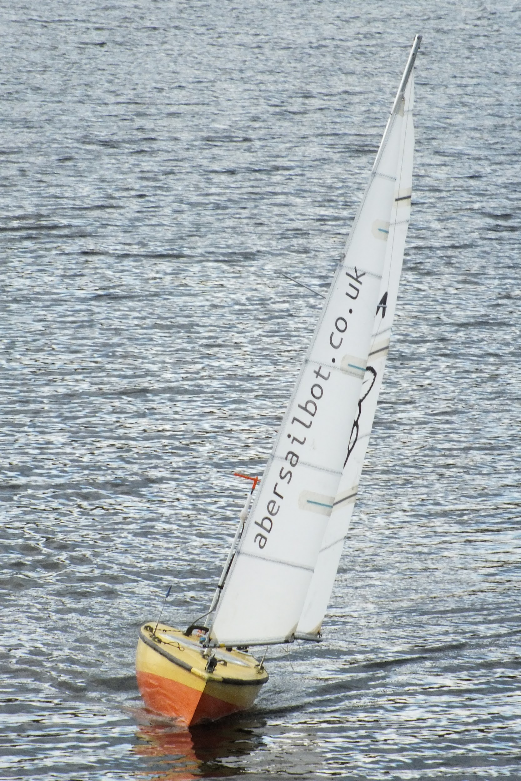
What do we do?
Build Autonomous Robotic Sailing Boats
Write code
Compete
Come 3rd...
fb.com/abersailbot @abersailbot sailbot@aber.ac.uk
Notes:
Robotic Boats
RC and Sail Themselves
Code (boatd etc)
Competitions
Microtransat
Not alone - community of people

Slide 4
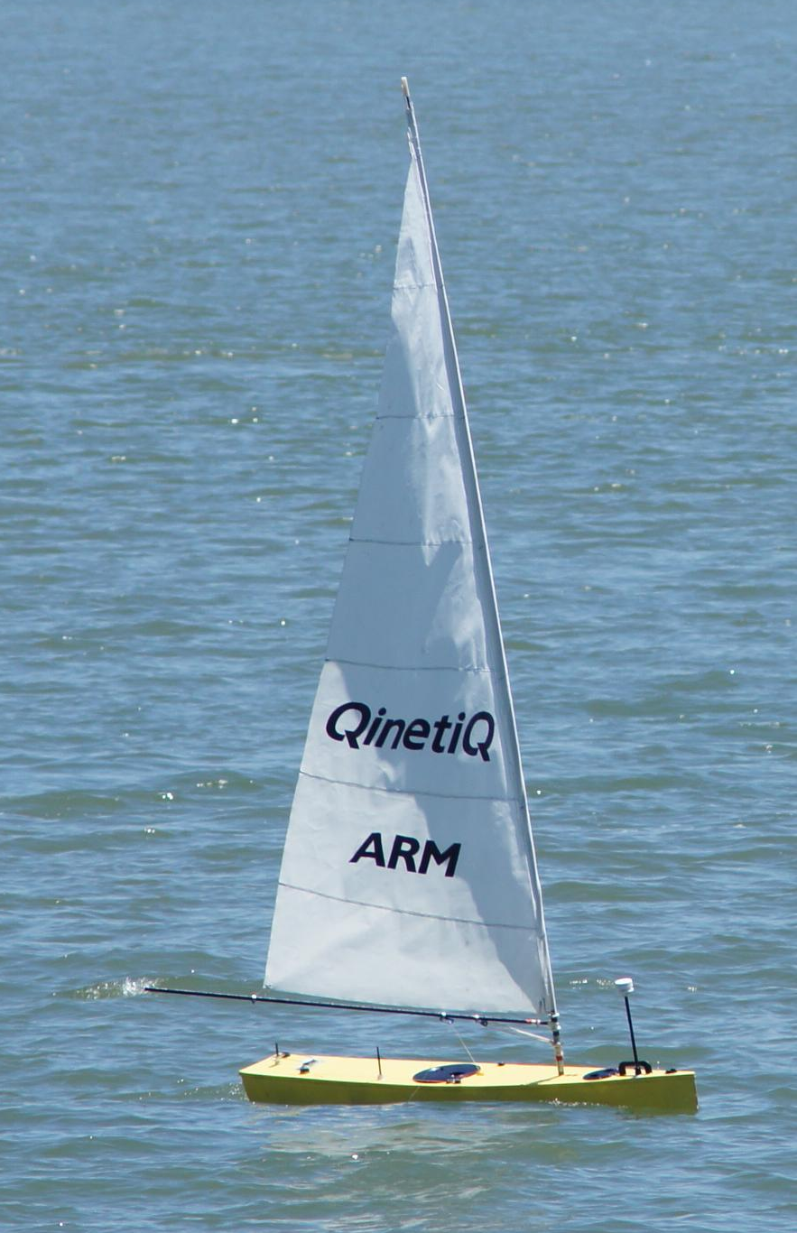
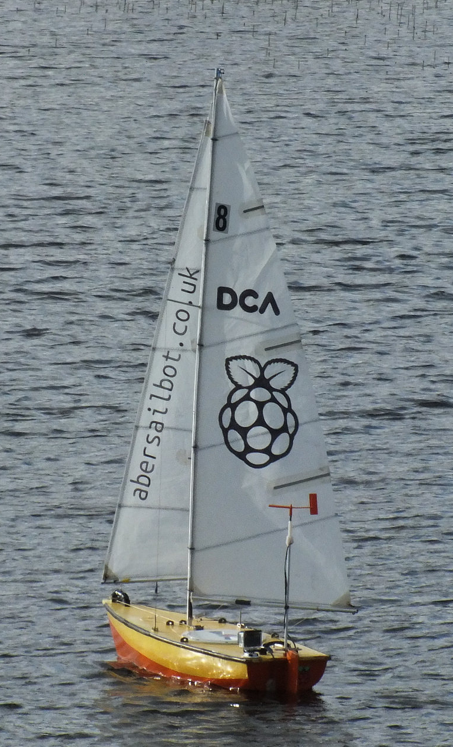
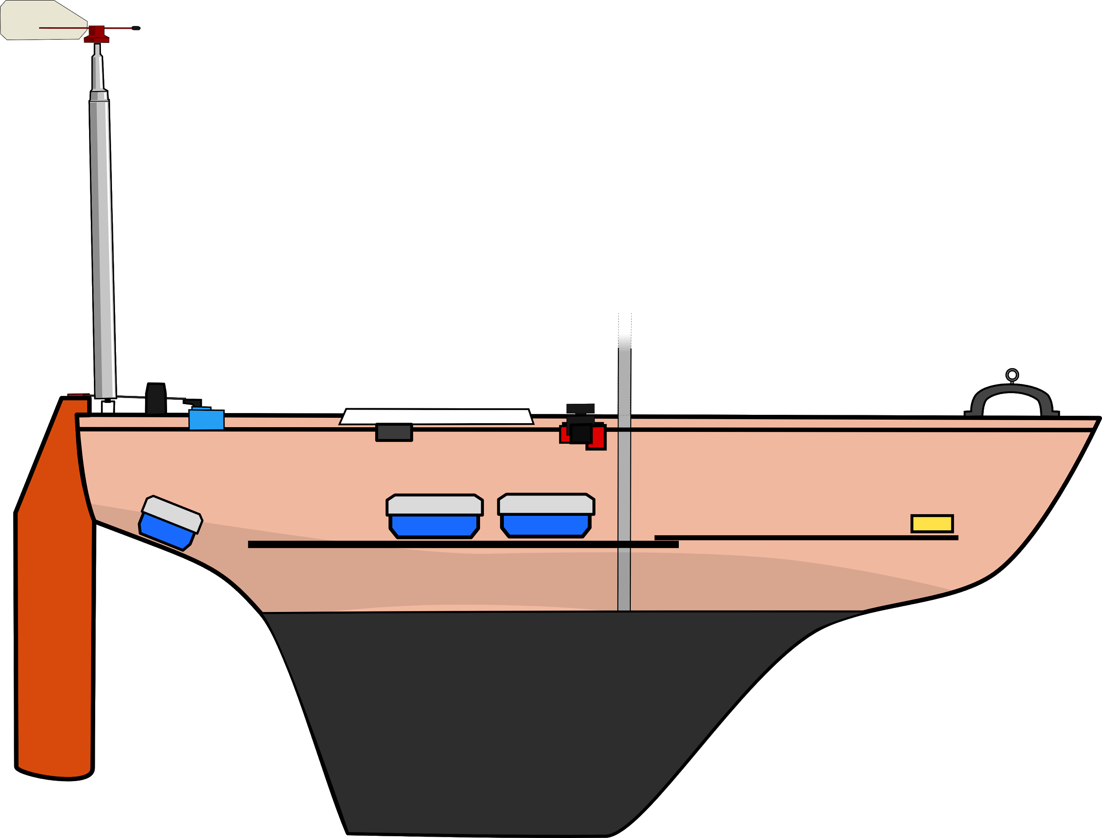
The Boats
Dewi’r Ddraig
Kitty
fb.com/abersailbot @abersailbot sailbot@aber.ac.uk
Notes:
Dewi’r Ddraig
Facts
Main and Jib
Maxi-MOOP hull - Paul Miller
1.2M, not the fastest, strong wind
Stable & reliable
New
Wind Sensor - dept design (rotary encoder)
Handle
Storm Sails
Electronics…
We have a simulator...
Kitty
Still work to be done
Needs new sail
Boat much larger
Detachable keel

Slide 5

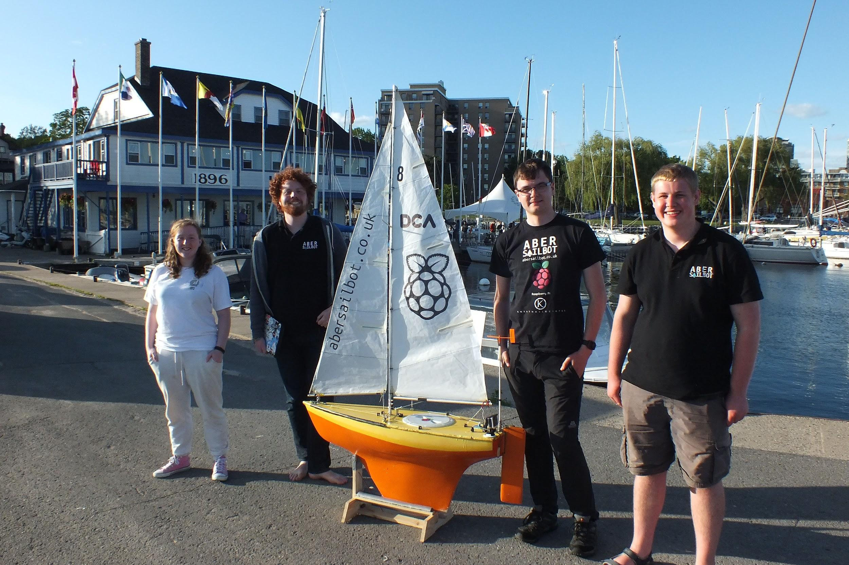
Competitions
Sailbot
Kingston, ON, Canada - 2016
We came 3rd
Fleet Race
Station Keeping
Payload
Long Distance
fb.com/abersailbot @abersailbot sailbot@aber.ac.uk
Notes:
International Robotic Sailing Regatta (known as Sailbot)
Annual - North America
University teams
RC and Autonomous

Slide 6
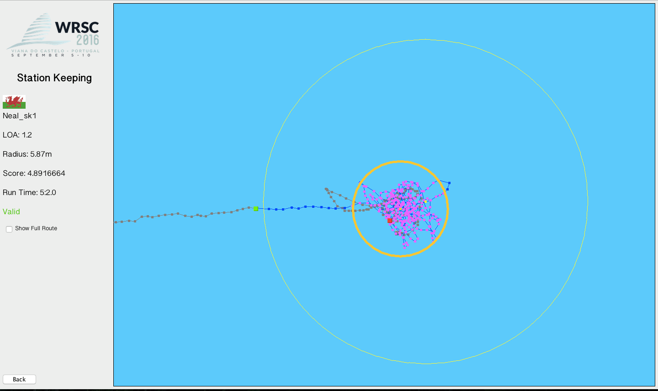

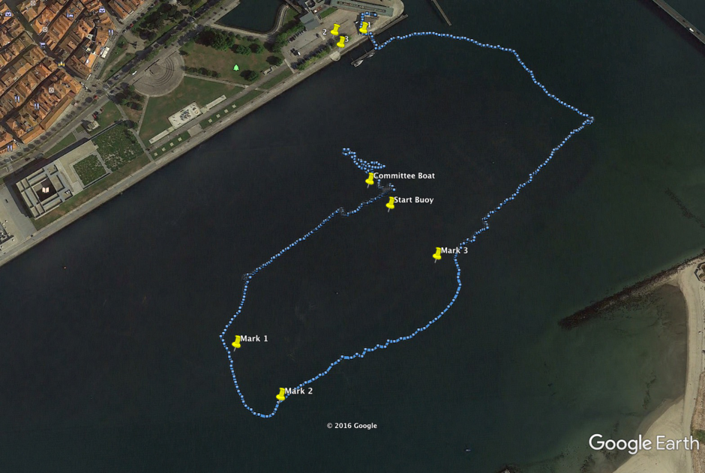
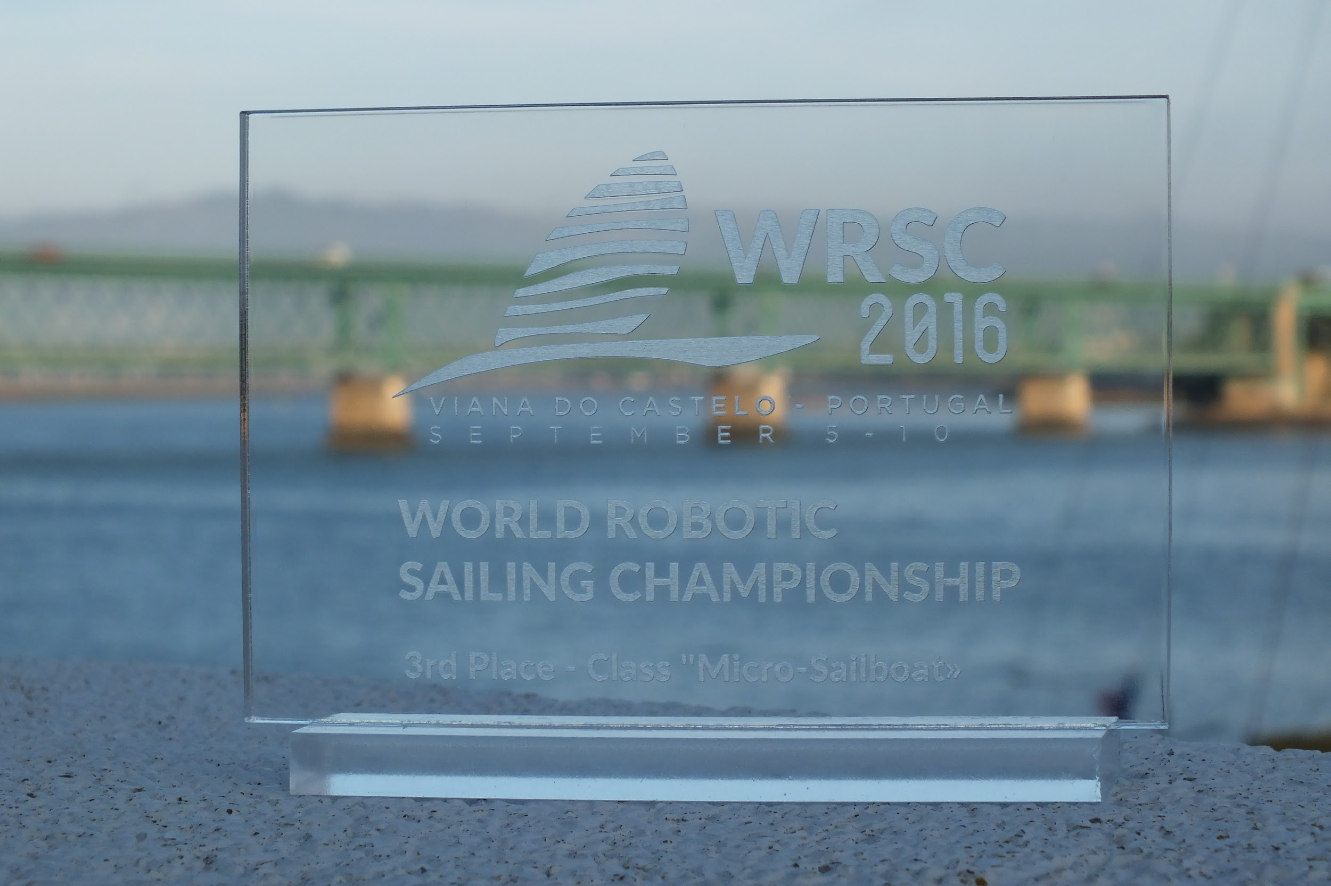
Competitions
WRSC
Viana Do Castelo, Portugal - 2016
We came 3rd...again
Fleet Race
Virtual Anchoring
Area Scanning
Vision
fb.com/abersailbot @abersailbot sailbot@aber.ac.uk
Notes:
World Robotic Sailing Championships (WRSC)
Annual competition
Across the globe
Hosted by Aberystwyth
Larger scale than Sailbot - similar challenges and rules.
Varying sizes - motor boat

Slide 7


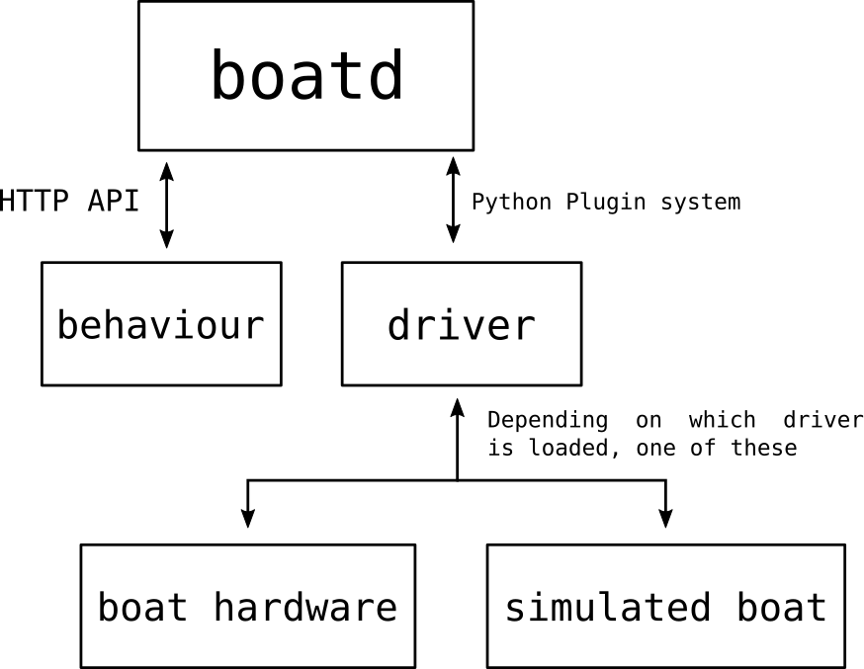
https://github.com/abersailbot
Software
Robotic Sailing Boat Daemon
Independant behaviours
Boat specific drivers
boatd
fb.com/abersailbot @abersailbot sailbot@aber.ac.uk
Notes:
---TOM---
Boat Daemon
Open Source
Run boat control behaviour (any language)
Talking to boat via driver
Functions: Great Circle

Slide 8
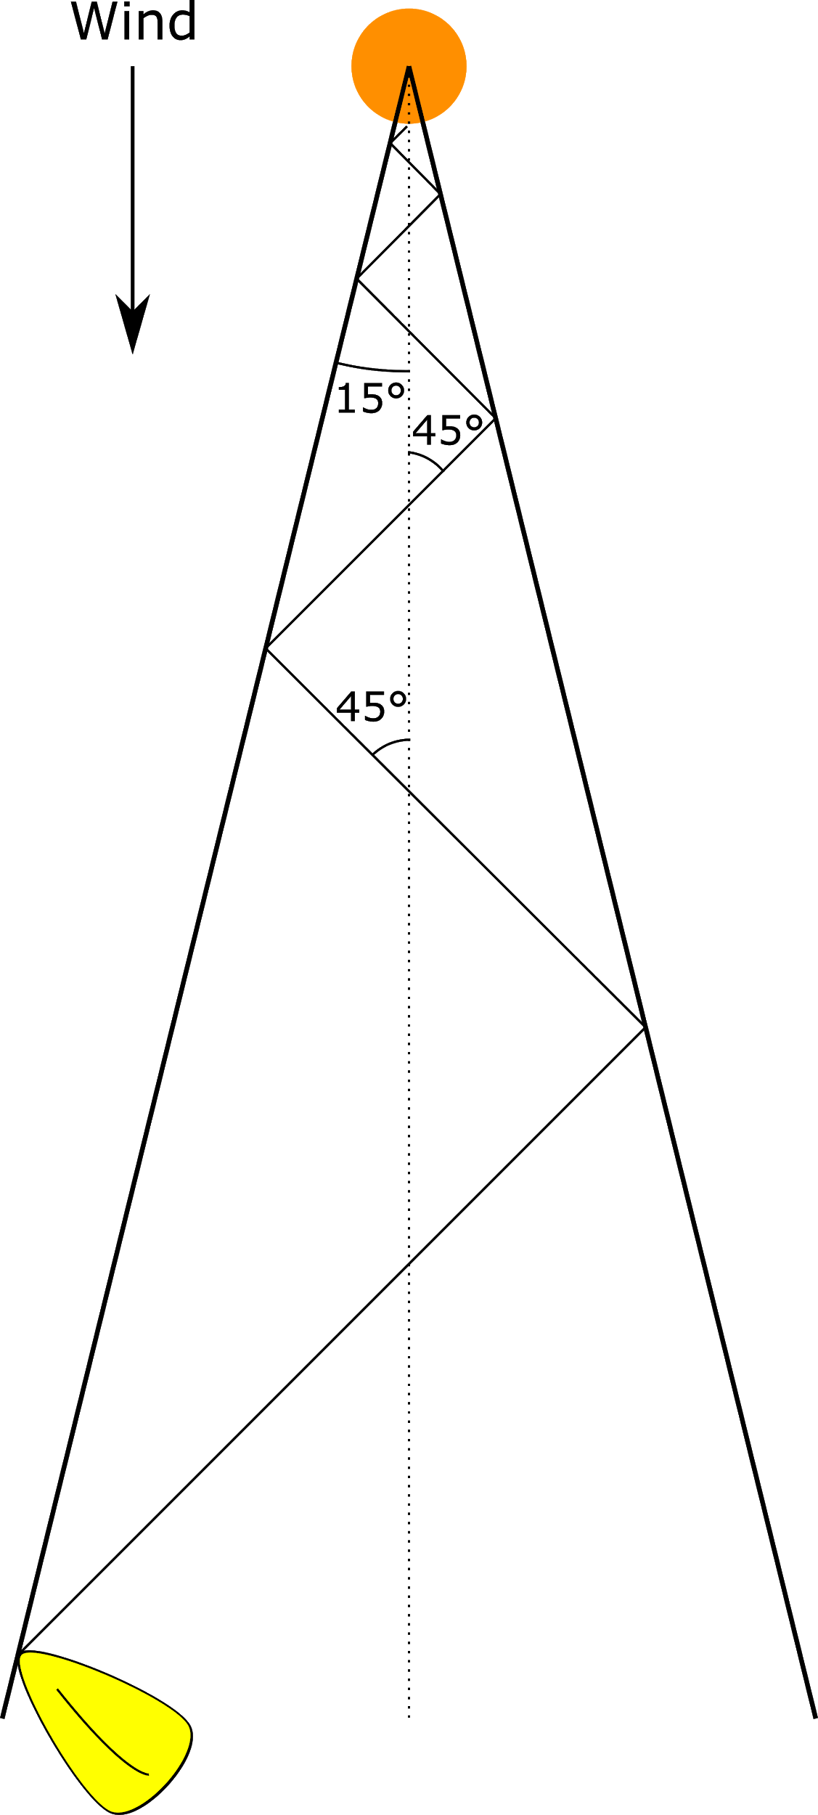
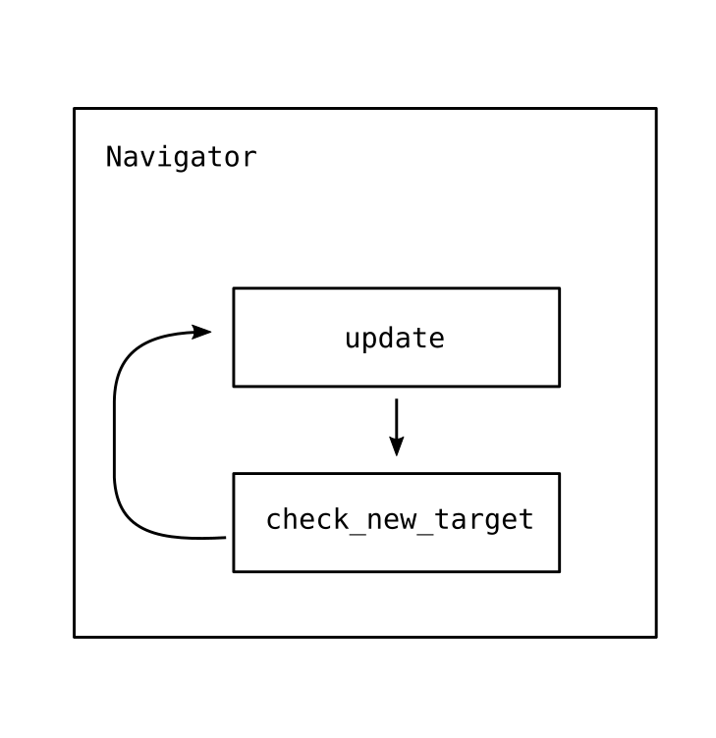
Behaviour
fb.com/abersailbot @abersailbot sailbot@aber.ac.uk
Notes:
Beating:
What it is
Why
Angle - wind from boat - check if >15*
Sail 45* to wind
Navigator
Speak to boatd
Load behaviour - station keep etc.

Slide 9
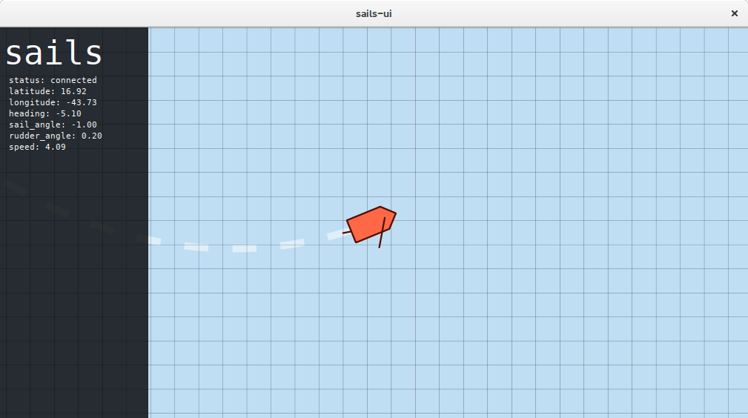
Simulation
https://github.com/sails-simulator
fb.com/abersailbot @abersailbot sailbot@aber.ac.uk
Notes:
sailsd
Louis Taylor - now left
Written in C
Simulates sailing physics
Run with boatd
JSON over TCP Socket

Slide 10
Telemetry
APMPlanner2
MAVLink over XBee
fb.com/abersailbot @abersailbot sailbot@aber.ac.uk
Notes:
MAVLink protocol - XBee
2.4
APM Planner 2
Plot points -> send to Dewi
See live position

Slide 11
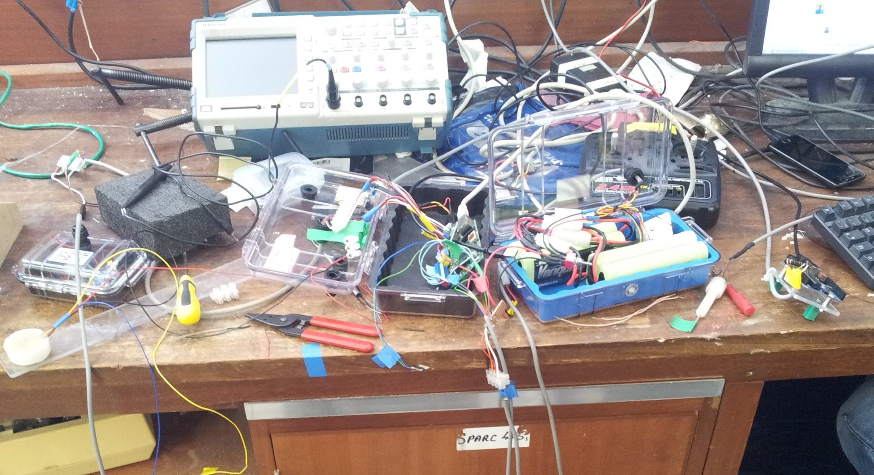
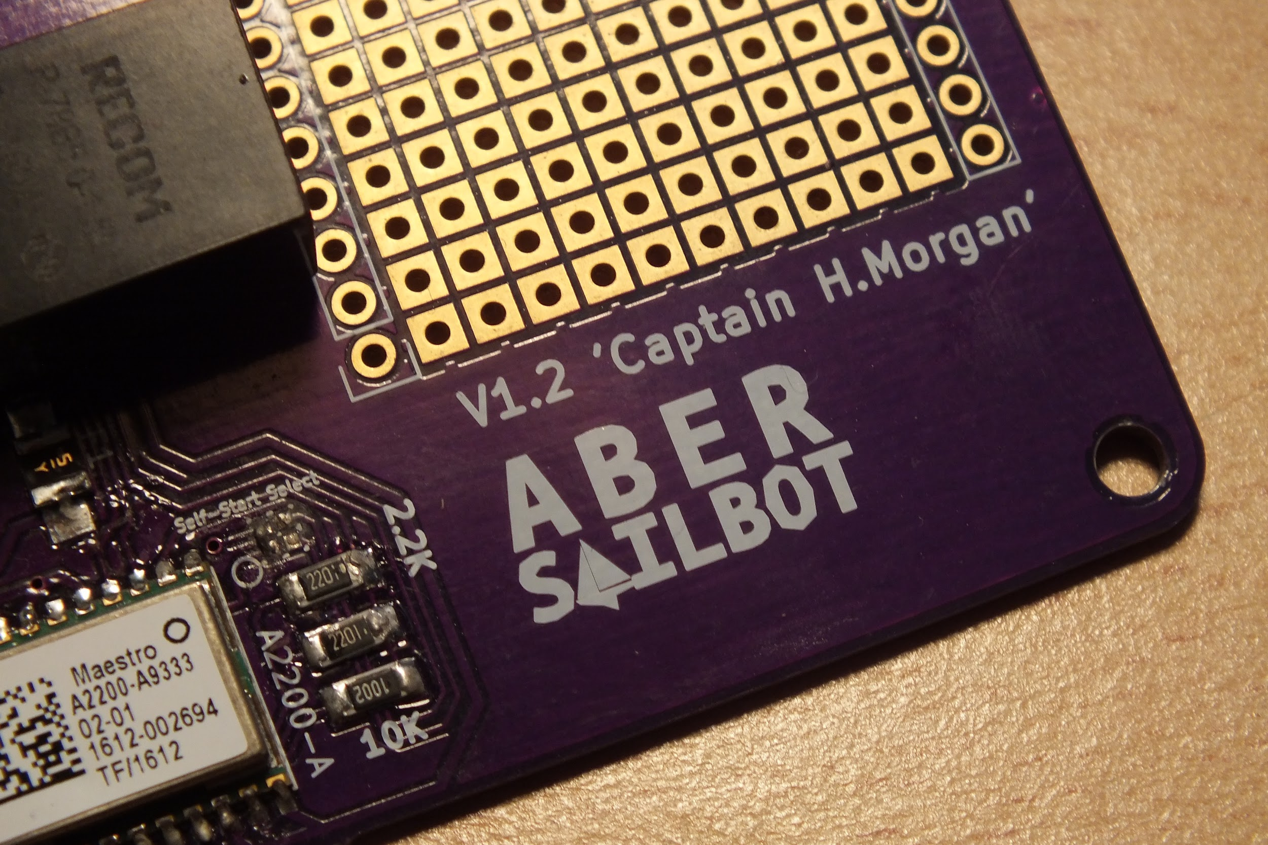
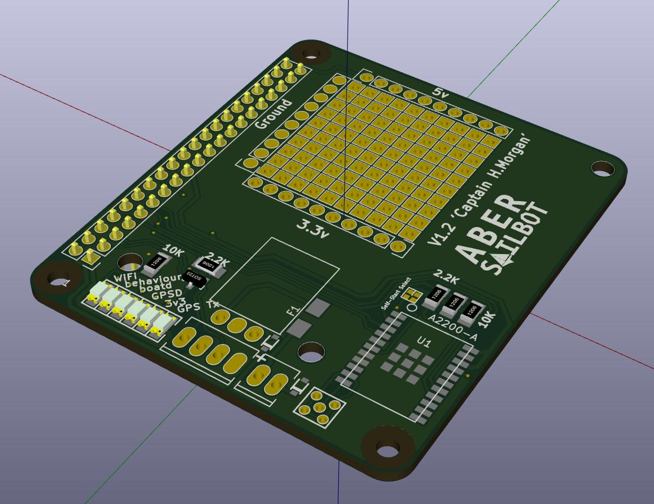
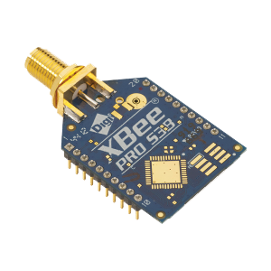
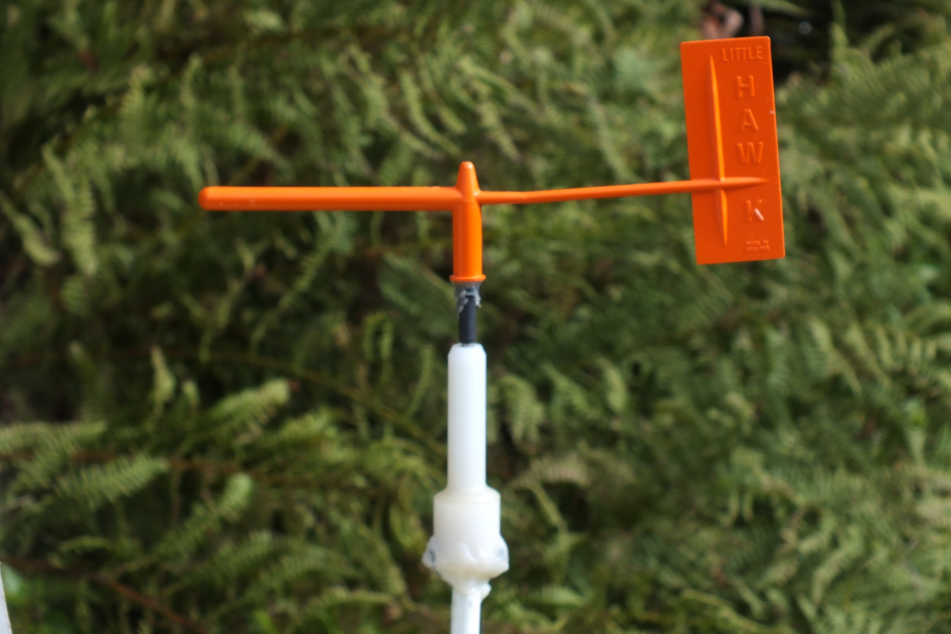
Electronics
RaspberryPi and Arduino
Designing a PCB
Wind Sensor
Compass
fb.com/abersailbot @abersailbot sailbot@aber.ac.uk
Notes:
RaspberryPi
Python
WiFi Access
Arduino
More maintainable and reliable, tidy
PCB - Captain H. Morgan
Wind Sensor - Designed by dept
Was Messy

Slide 12
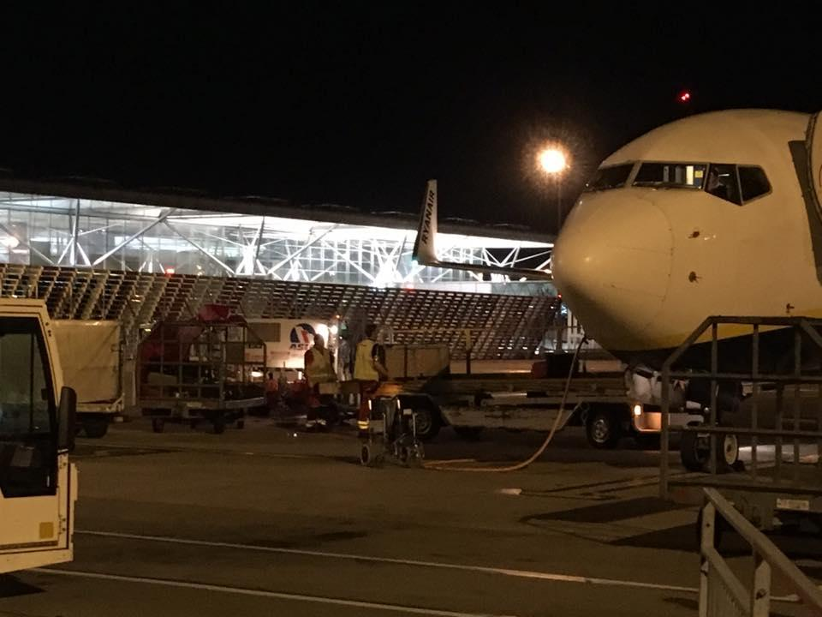
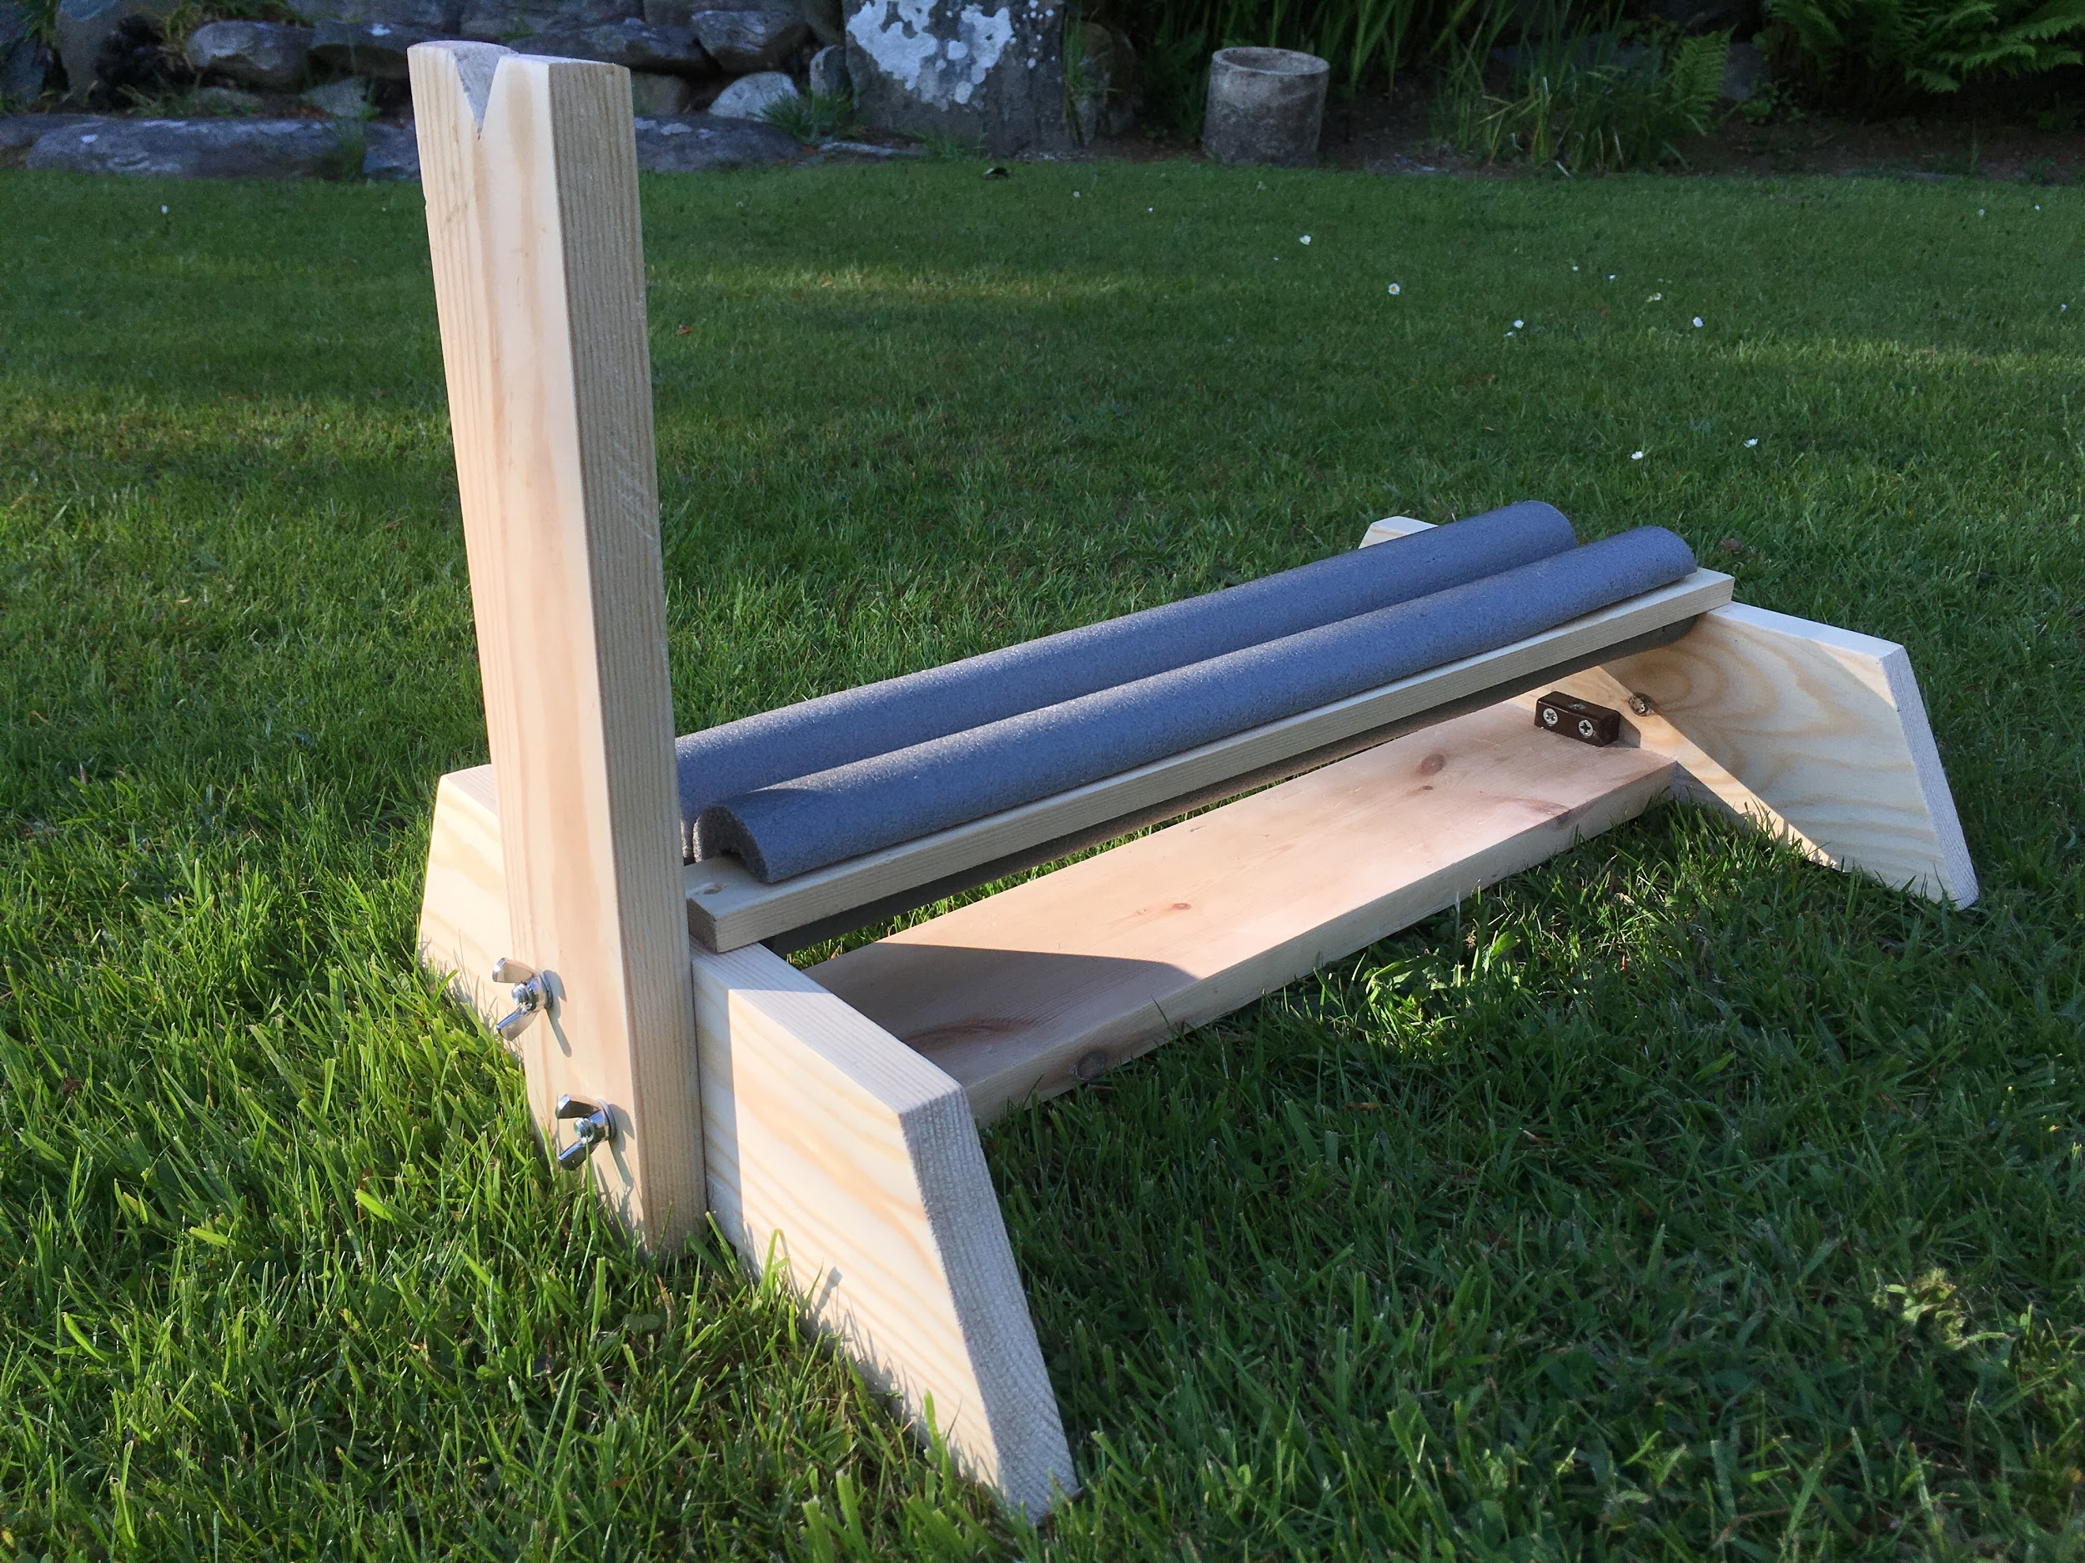
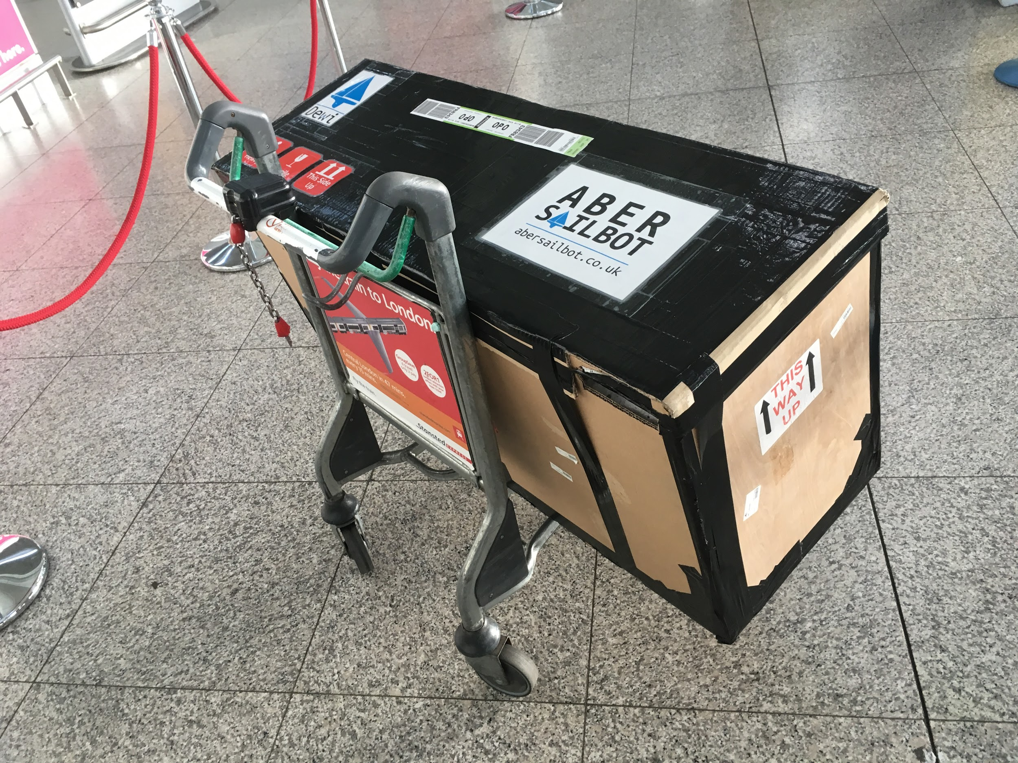
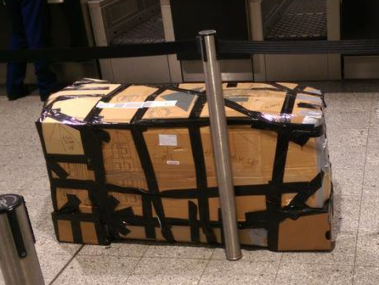
Transport
fb.com/abersailbot @abersailbot sailbot@aber.ac.uk
Notes:
Old Box & New Replacement
Transporting to Canada
Replacement stand

Slide 13
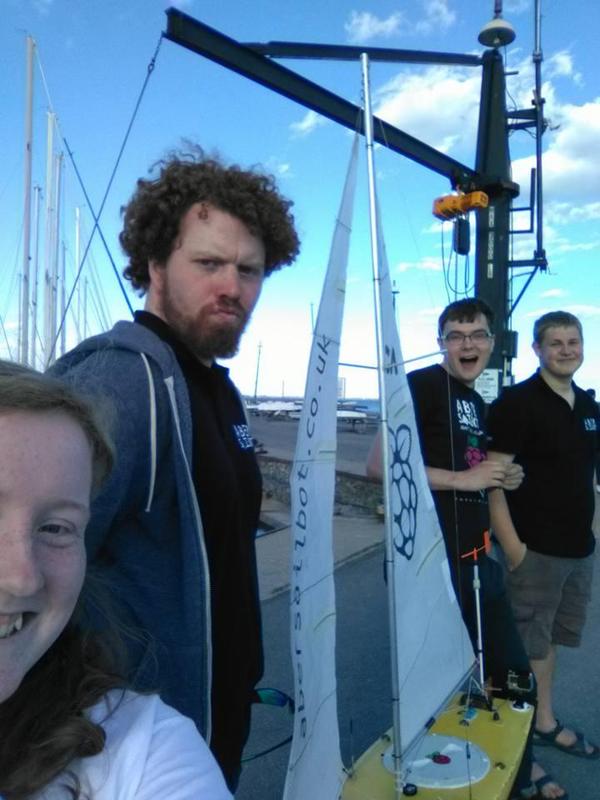
Thanks for Listening!
JOIN US!
abersailbot.co.uk/joinus
fb.com/abersailbot @abersailbot sailbot@aber.ac.uk
Notes:
Fill form (abersailbot.co.uk/joinus)
Give us email in ThinkTank
Facebook Message, Tweet, Email

